Slide 1
How to Support Your Child With Spelling
Harlaxton C of E Primary School and Denton C of E Primary School.

Slide 2

Why Read Write Inc Spelling?
We currently use the RWI phonics programme in both schools.
Our Teachers and Teaching Assistants are trained in the Read Write Inc programme to be able to provide your children with the necessary skills to read. There are additional benefits with this programme to develop writing, punctuation, grammar, spelling and handwriting. This scheme encourages children to work together and also gives them the skills to self assess and edit their work – an important aid to learning. By using the RWI Spelling programme, the familiarity of the format and the structure will enable to children to access this new resource with confidence.

Slide 3
Why Read Write Inc?
How does this programme support your child in learning to spell?
RWInc Spelling is an interactive programme which teaches spellings in a fun and engaging way. Each unit is introduced with a short video. It helps children to learn spellings with common patterns and uses rules in order to help them recall spellings as well as teaching exceptions to these rules.

Slide 4
Log Books for Home Learning
Each child has a Log Book and these are important in helping them to practise the spellings they need to learn from each unit. Each unit explains the spelling rules and gives handy tips and rhymes for remembering them.

Slide 5
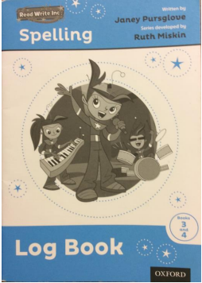
Using the Log Books to support at home.
During the week the children will log the spellings they found tricky.
Try to make sure that the Log Book is used to practise tricky spellings regularly, revisiting spellings from previous weeks or expected spellings from their year group.

Slide 6
Group Words Together with The Same Rule
Ask your child to explain the rule for the week and get them to give you example words so that you can build up a word bank that can be frequently referred to.

Slide 7
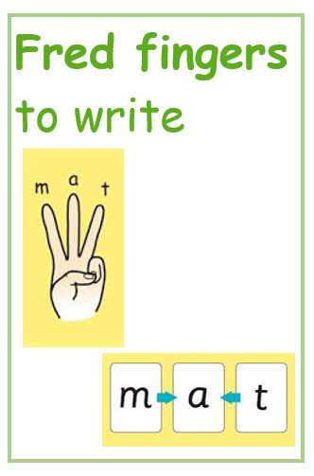
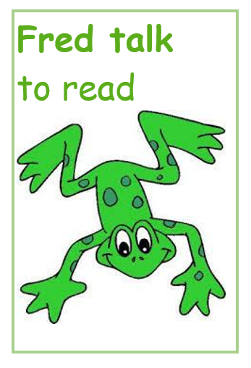
Fred Talk
Fred teaches the children to use their fingers to break down words. In phonics we use a puppet called fred the frog who can only speak in sounds not whole words.
The word ‘CAT’ = C-A-T this will have 3 fingers and one sound is put on each finger in turn, working left to right
The word ‘SHIP’ will also have 3 fingers = SH-I-P
The word ‘FLAG’ would have 4 fingers F-L-A-G

Slide 8
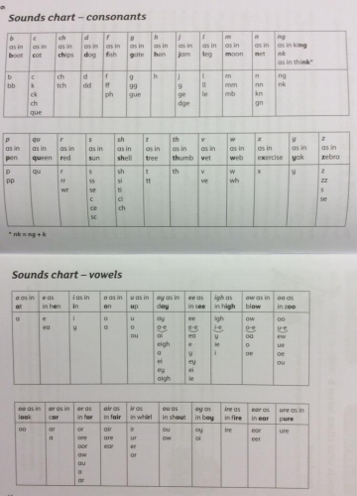
Sounding Out Words to Spell
When your child is writing for their homework remind them to use their dots and dashes and ‘fred fingers’ to spell.
The Sounds chart at the front of the Log Book is very important in helping children to select groups of letters to spell.

Slide 9
Root Words
When the children are trying to spell independently, support them in identifying the root word first to help them to:
1. Use their ‘fred fingers’ and dots and dashes to identify the sounds that make up that word
2. Add the correct suffix/prefix (or both!) using the rules they have learnt through the spelling programme

Slide 10
RED and ORANGE words
Use the Log Book to log high frequency words which
you notice your child is spelling wrong (remember that
these are quite often RED WORDS and that you ‘Can’t
fred a red!’)
Use word lists in Log Books to learn spellings which
are for their specific spelling group.

